Slide 1
ELECTRICAL SCIENCE-1 (15B11EC111) UNIT-2 Lecture-6

Slide 2
Topics to be Discussed
Nodal analysis
Practice Problem
References

Slide 3
Nodal Analysis

Slide 4
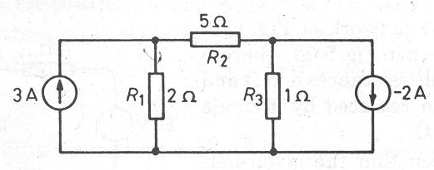
Example 4
Let again tackle Example 2, by writing the matrix equations just by inspection.

Slide 5
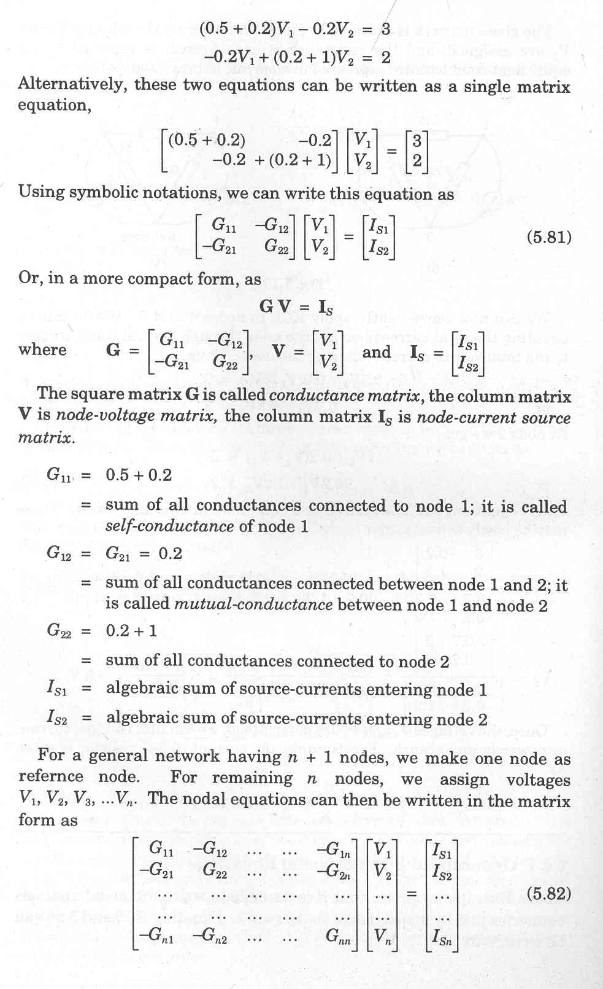
Conductance matrix. G₁₁ = Self-conductance of node 1. G₁₂= Mutual conductance between node 1 and 2.

Slide 6
Node-voltage Matrix.
Node current-source Matrix.
Note that all the elements on the major diagonal of matrix G are positive.
All off-diagonal elements are negative or zero.

Slide 7
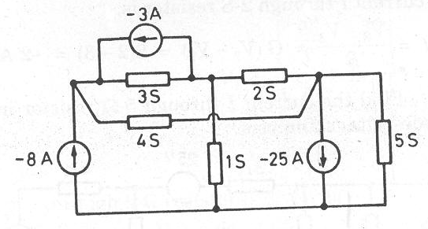
Example 5
Solve the following network using the node-voltage analysis, and determine the current through the 2-S resistor.

Slide 8
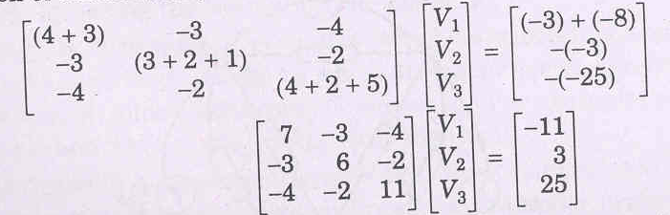
We can write the nodal voltage equation in matrix form, directly by inspection :

Slide 9
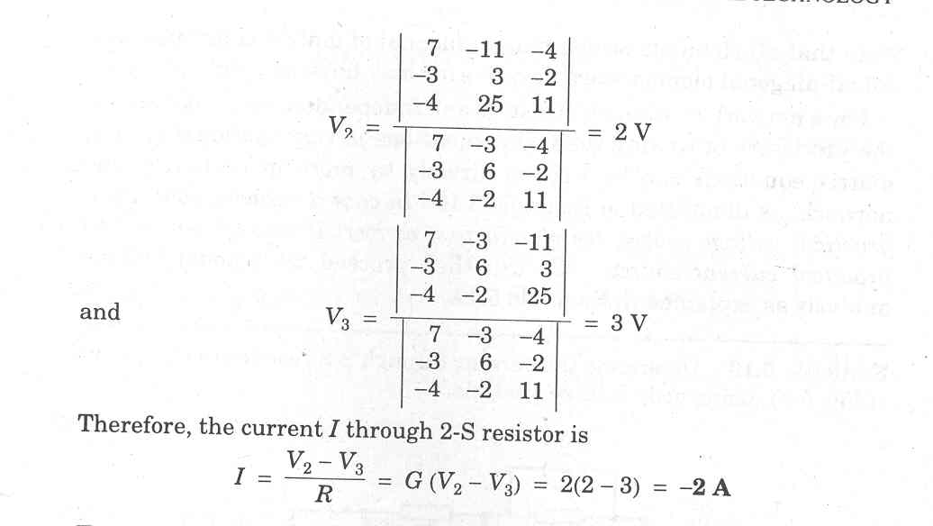
Current through 2-S resistor is

Slide 10
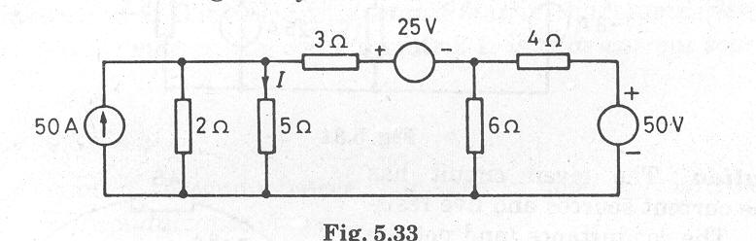
Example 6
Solve the following network using the node-voltage analysis, and determine the current I through the 5-Ω resistor.

Slide 11
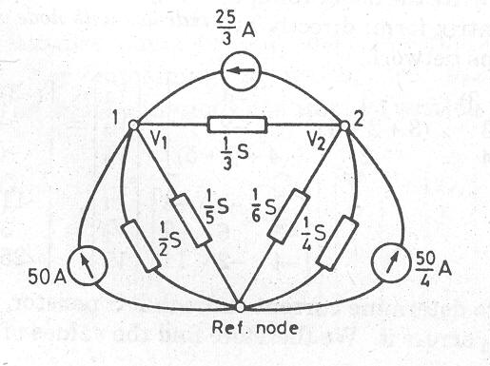
Solution

Slide 12
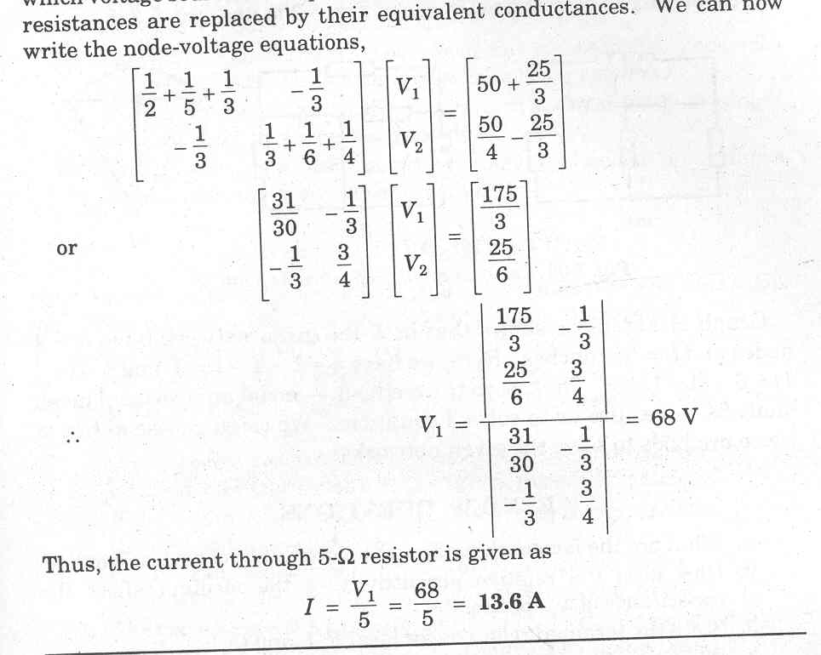

Slide 13
The current through 5-Ω resistor,

Slide 14
Choice Between the TWO
We select a method in which the number of equations to be solved is less.
The number of equations to be solved in mesh analysis is
b – (n – 1)
The number of equations to be solved in nodal analysis is
(n – 1)

Slide 15
REFERENCES
[1] R.C. Dorf and James A. Svoboda, “Introduction to Electric Circuits”, 9th ed, John Wiley & Sons, 2013.

